Slide 1
Network+ Guide to Networks Eighth Edition
Chapter 8
Subnets and V LANs
© 2019 Cengage. All Rights Reserved. May not be copied, scanned, or duplicated, in whole or in part, except for use as permitted in a license distributed with a certain product or service or otherwise on a password-protected website for classroom use.

Slide 2
Objectives
8.1 Explain the purposes of network segmentation
8.2 Calculate and implement subnets
8.3 Explain how V LANs work and how they’re used

Slide 3
Network Segmentation (1 of 2)
When a network is segmented into multiple smaller networks:
Traffic on one network is separated from another network’s traffic
Each network is its own broadcast domain
Segmentation accomplishes the following:
Enhance security
Improve performance
Simplify troubleshooting

Slide 4
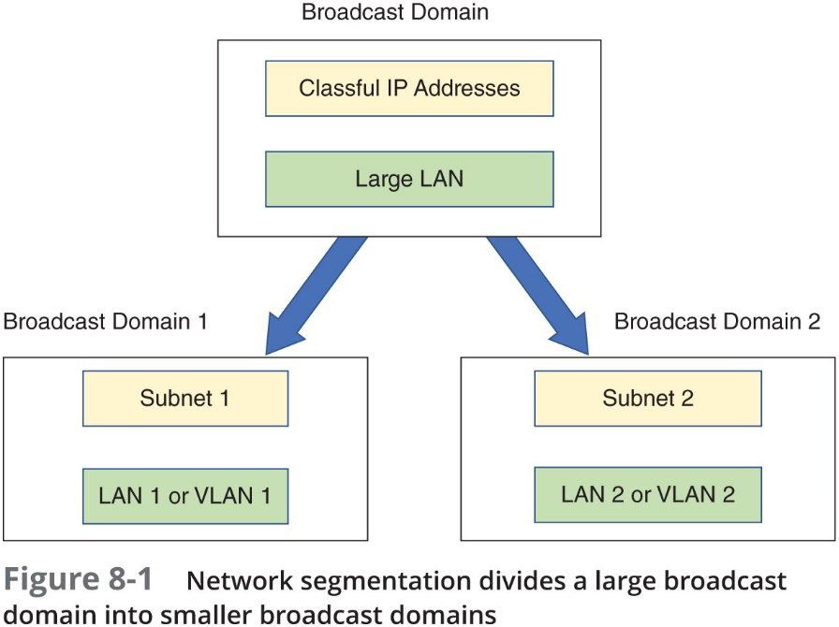
Network Segmentation (2 of 2)
Networks are commonly segmented according to one of the following groupings:
Geographic locations
Departmental boundaries
Device types

Slide 5
Subnets (1 of 3)
Example: A business has grown from 20 or 30 computers to having a few hundred computers and devices:
There is only a single LAN or broadcast domain
One router serves as the default gateway for the entire network
To better manage network traffic, segment the network so that each floor contains one LAN, or broadcast domain
Install a router on each floor
You will need to configure clients on each subnet so they know which devices are on their own subnet
Divide the pool of I P addresses into three groups or subnets (technique called subnetting)

Slide 6
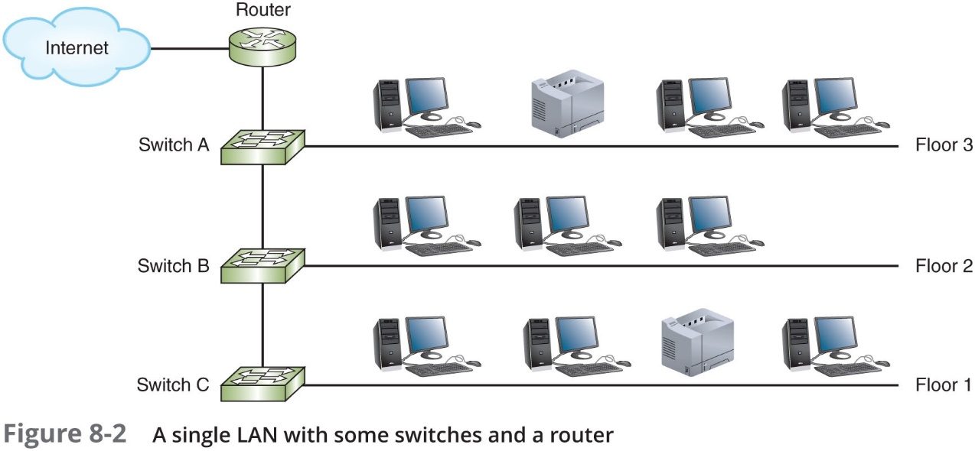
Subnets (2 of 3)

Slide 7
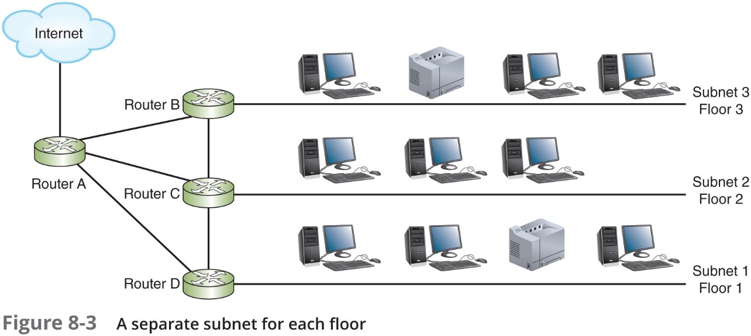
Subnets (3 of 3)

Slide 8
How Subnet Masks Work (1 of 2)
I P v 4 address is divided into two parts:
Network I D and host I D
Subnet mask is used so devices can determine which part of an I P address is network I D and which part is the host I D:
Number of 1s in the subnet mask determines the number of bits in the IP address belong to the network I D
I P address 192.168.123.132 in binary:
11000000.10101000.01111011.10000100
Subnet mask 255.255.255.0 in binary:
11111111.111111111.111111111.00000000
Network I D: 192.168.123.0
Host portion: 0.0.0.132

Slide 9
How Subnet Masks Work (2 of 2)
Table 8-2 Default I P v 4 subnet masks
Network class | Default subnet mask (binary) | Number of bits used for the network information | Default subnet mask (dotted decimal)
A | 11111111 00000000 00000000 00000000 | 8 | 255.0.0.0
B | 11111111 11111111 00000000 00000000 | 16 | 255.255.0.0
C | 11111111 11111111 11111111 00000000 | 24 | 255.255.255.0

Slide 10
C I D R (Classless Interdomain Routing)
C I D R:
Provides additional ways of arranging network and host information in an IP address
Takes the network I D or a host’s IP address and follows it with a forward slash (/), followed by the number of bits used for the network I D
192.168.89.127/24:
24 represents the number of 1s in the subnet mask and the number of bits in the network I D
Known as a C I D R block

Slide 11
I P v 4 Subnet Calculations (1 of 3)
Subnetting:
Alters the rules of classful I P v 4 addressing
Called classless addressing
Borrow bits that would represent host information
Use those bits instead to represent network information
Increase the number of bits available for the network I D (increase number of networks)
Reduce the number of bits available for identifying hosts (decrease number of hosts per network)

Slide 12
I P v 4 Subnet Calculations (2 of 3)
Table 8-4 Steps to divide IP addresses for network I D 192.168.89.0 into two subnets
Step 1: Borrow from host bits
Network ID | 192 | 168 | 89 | 0
In binary | 11000000 | 10101000 | 01011001 | 00000000
Borrow 1 bit | 11000000 | 10101000 | 01011001 | 00000000
Step 2: Determine the subnet mask
In binary | 11111111 | 11111111 | 11111111 | 10000000
In decimal | 255 | 255 | 255 | 128
Step 3: Determine the network IDs
Network ID 1 | 11000000 | 10101000 | 01011001 | 00000000
In decimal | 192 | 168 | 89 | 0
In C I D R notation | 192.168.89.0/25 | blank | blank | blank
Network ID 2 | 11000000 | 10101000 | 01011001 | 10000000
In decimal | 192 | 168 | 89 | 128
In CIDR notation | 192.168.89.128/25 | blank | blank | blank

Slide 13
I P v 4 Subnet Calculations (3 of 3)
Table 8-4 (Continued)
Step 4: Determine range of host IP addresses
Subnet 1: | blank | blank | blank | blank
First host, binary | 11000000 | 10101000 | 01011001 | 00000001
First host decimal | 192 | 168 | 89 | 1
Last host, binary | 11000000 | 10101000 | 01011001 | 01111110
Last host, decimal | 192 | 168 | 89 | 126
Subnet 2: | blank | blank | blank | blank
First host, binary | 11000000 | 10101000 | 01011001 | 10000001
First host, decimal | 192 | 168 | 89 | 129
Last host, binary | 11000000 | 10101000 | 01011001 | 11111110
Last host, decimal | 192 | 168 | 89 | 254

Slide 14
Subnet Mask Tables (1 of 3)
Class A, Class B, and Class C networks can be subnetted:
Each class has different number of host information bits usable for subnet information
Varies depending on network class and the way subnetting is used
Table 8-6 (see the next slide)
Lists the number of subnets and hosts that can be created by subnetting a Class B network
Table 8-7 (see the following slide)
Lists the numbers of subnets and hosts that can be created by subnetting a Class C network

Slide 15
Subnet Mask Tables (2 of 3)
Table 8-6 I P v 4 Class B subnet masks
Subnet mask | C I D R notation | Number of subnets on network | Number of hosts per subnet
255.255.128.0 | /17 | 2 | 32,766
255.255.192.0 | /18 | 4 | 16,382
255.255.224.0 | /19 | 8 | 8190
255.255.240.0 | /20 | 16 | 4094
255.255.248 | /21 | 32 | 2046
255.255.252.0 | /22 | 64 | 1022
255.255.254.0 | /23 | 128 | 510
255.255.255.0 | /24 | 256 | 254
255.255.255.128 | /25 | 512 | 126
255.255.255.192 | /26 | 1024 | 62
255.255.255.224 | /27 | 2048 | 30
255.255.255.240 | /28 | 4096 | 14
255.255.255.248 | /29 | 8192 | 6
255.255.255.252 | /30 | 16,384 | 2

Slide 16
Subnet Mask Tables (3 of 3)
Table 8-7 I P v 4 Class C subnet masks
Subnet mask | C I D R notation | Number of subnets on network | Number of hosts per subnet
255.255.255.128 | /25 | 2 | 126
255.255.255.192 | /26 | 4 | 62
255.255.255.224 | /27 | 8 | 30
255.255.255.240 | /28 | 16 | 14
255.255.255.248 | /29 | 32 | 6
255.255.255.252 | /30 | 64 | 2

Slide 17
Subnetting Questions on Exams
Likely to see two types of subnet calculation problems:
Given certain network requirements (required number of hosts or subnets), calculate possible subnets and host I P address ranges
Given an I P address, determine its subnet’s network I D, broadcast address, and first/last host addresses

Slide 18
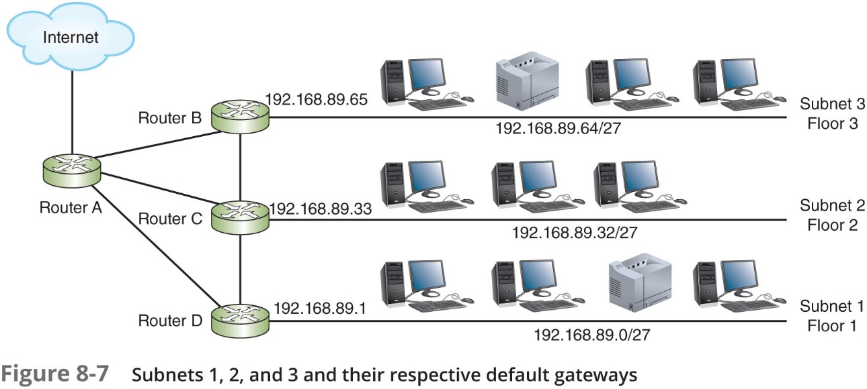
Implement Subnets (1 of 3)
Figure 8-7 shows the subnets assigned to the three LANs earlier in Figure 8-3

Slide 19
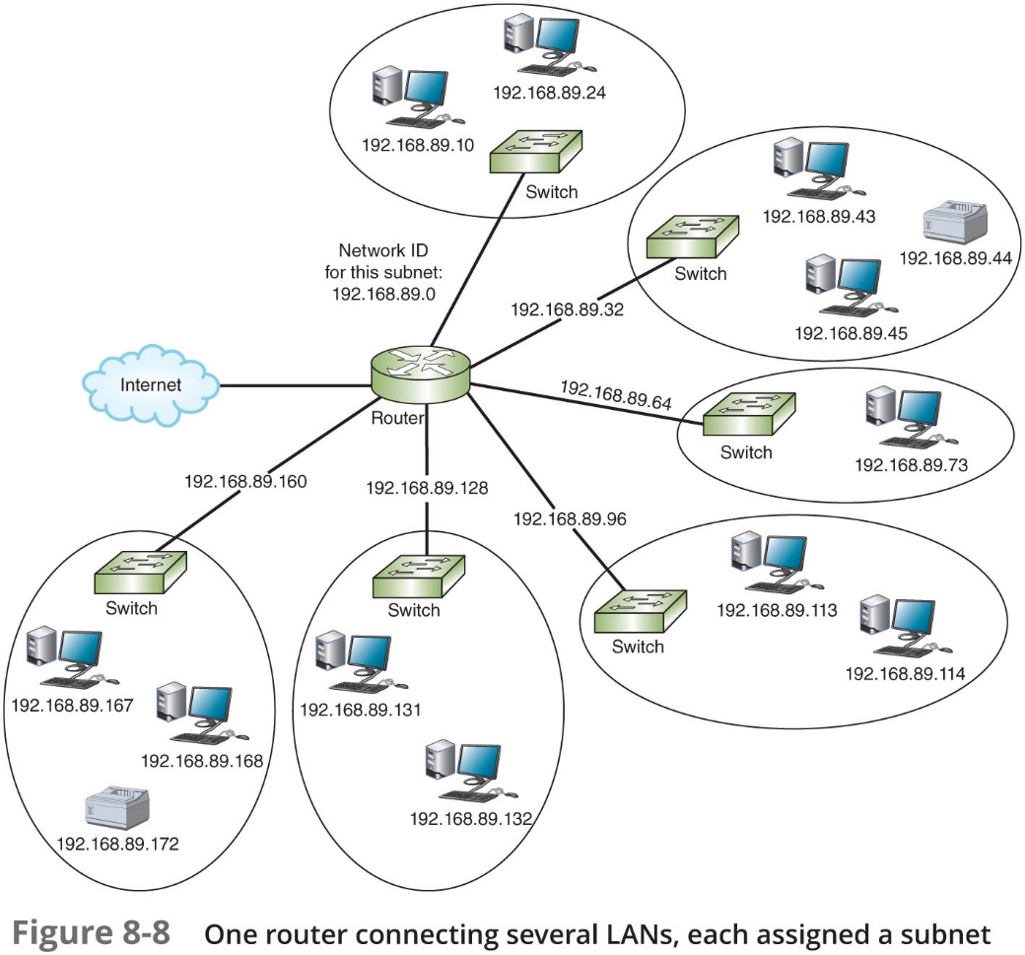
Implement Subnets (2 of 3)
Figure 8-8 illustrates a network subnetted into 6 smaller networks

Slide 20
Implement Subnets (3 of 3)
A centrally managed D H C P server can provide D H C P assignments to multiple subnets with the help of D H C P relay agent:
A router, firewall, or Layer 3 switch receives the D H C P request from a client in one of its local broadcast domains
The Layer 3 device creates a message of its own and routes this transmission to the specified D H C P server in a different broadcast domain
D H C P server notes the relay agent’s IP address and assigns the D H C P client an I P address on the same subnet

Slide 21
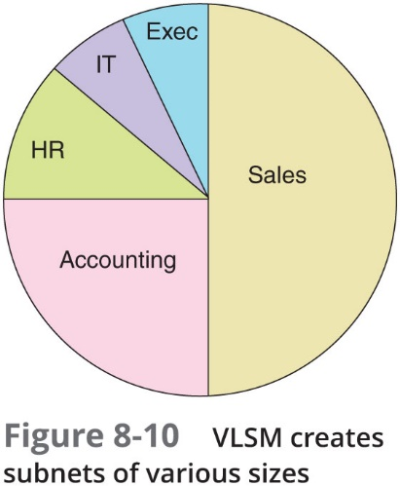
V L S M (Variable Length Subnet Mask) (1 of 3)
V L S M:
Allows subnets to be further subdivided into smaller and smaller groupings until each subnet is about the same size as the necessary IP address space
Often referred to as “subnetting a subnet”
To create V L S M subnets:
Create the largest subnet first
Create the next largest subnet, and the next one, and so on

Slide 22
V L S M (Variable Length Subnet Mask) (2 of 3)
Table 8-8 Subnets of various sizes needed on the network
Subnet | Included hosts | Number of hosts | C I D R notation (as calculated next)
1 | Sales | 120 | 192.168.10.0 /25
2 | Accounting | 58 | 192.168.10.128 /26
3 | H R | 25 | 192.168.10.192 /27
4 | I T | 6 | 192.168.10.224 /29
5 | Executives | 5 | 192.168.10.232 /29
6 | WAN link | 2 | 192.168.10.240 /30
7 | WAN link | 2 | 192.168.10.244 /30

Slide 23
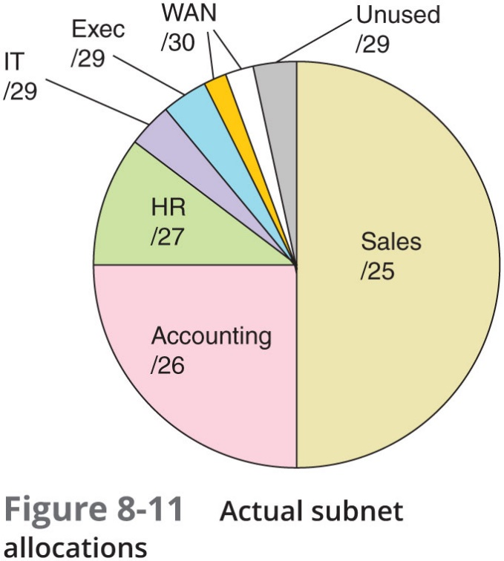
V L S M (Variable Length Subnet Mask) (3 of 3)

Slide 24
Subnets in I P v 6 (1 of 3)
Subnetting in I P v 6 is simpler than I P v 4
Classes not used
Subnet masks not used
Single I P v 6 subnet is capable of supplying 18,446,744,073,709,551,616 I P v 6 addresses
Subnetting helps administrators manage the enormous volume of I P v 6 addresses
I P v 6 address commonly written as eight blocks of four hexadecimal characters:
Last four blocks identify the interface
First four blocks identify the network and serve as the network prefix (also called the site prefix or global routing prefix)
Fourth hexadecimal block in the site prefix can be altered to create subnets

Slide 25
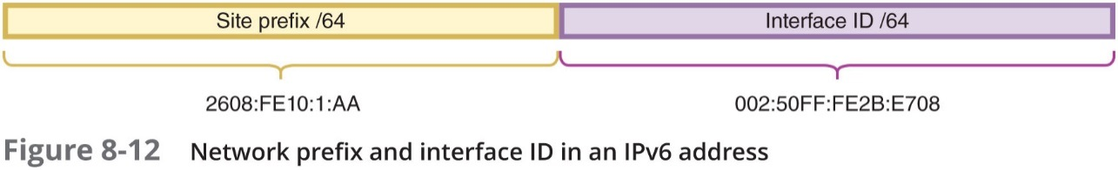
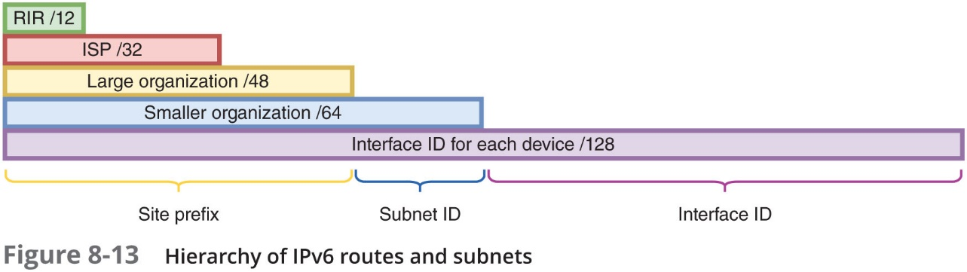
Subnets in I P v 6 (2 of 3)

Slide 26
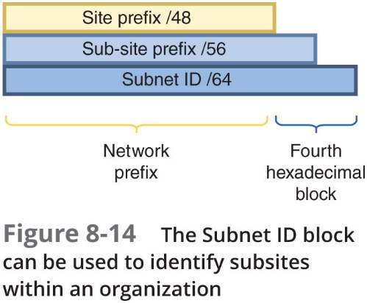
Subnets in I P v 6 (3 of 3)

Slide 27
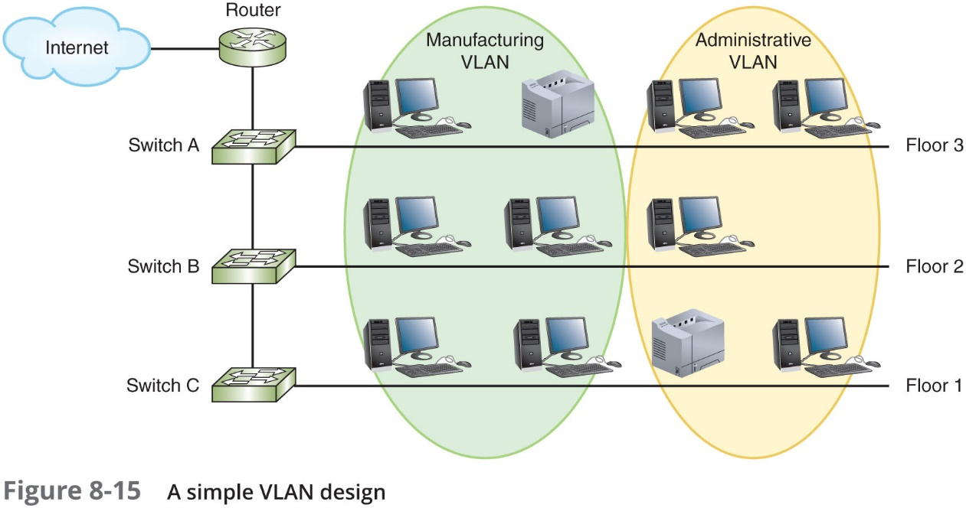
V L A Ns (Virtual Local Area Networks) (1 of 2)
V L A N (virtual local area network):
Groups ports on a switch so that some of the local traffic on the switch is forced to go through a router
Limiting traffic to a smaller broadcast domain

Slide 28
V L A Ns (Virtual Local Area Networks) (2 of 2)
Reasons for using V L A Ns:
Isolating connections with heavy or unpredictable traffic patterns
Identifying groups of devices whose data should be given priority handling
Containing groups of devices that rely on legacy protocols incompatible with the majority of the network’s traffic
Separating groups of users who need special security or network functions
Configuring temporary networks
Reducing the cost of networking equipment

Slide 29
Managed Switches (1 of 8)
Unmanaged switch
Provides plug-and-play simplicity with minimal configuration
Has no I P address assigned to it
Managed switch:
Can be configured via a command-line interface or a web-based management G U I
Are usually assigned an IP address
V LANS can only be implemented through managed switches
Ports can be partitioned into groups

Slide 30
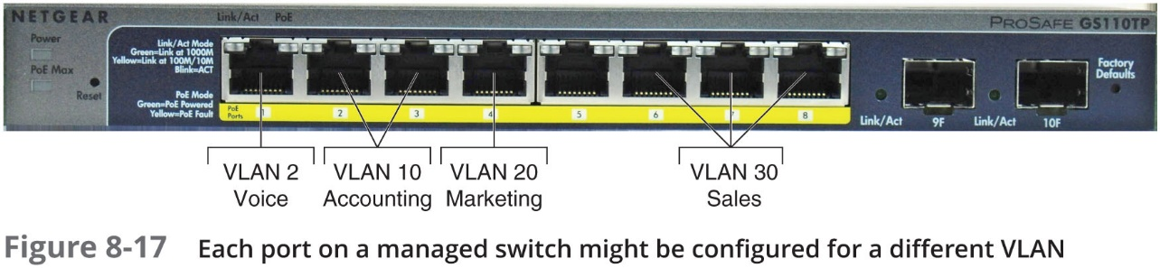
Managed Switches (2 of 8)

Slide 31
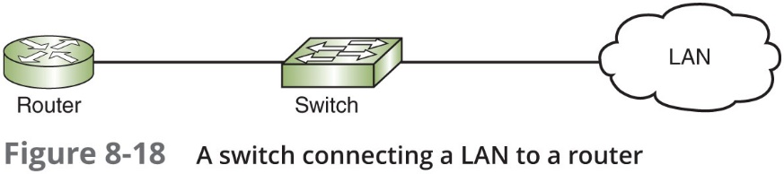
Managed Switches (3 of 8)
Figure 8-18 shows how a normal Layer 2 switch operates

Slide 32
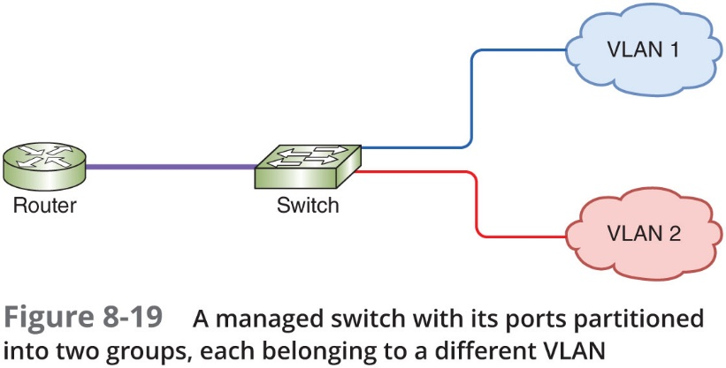
Managed Switches (4 of 8)
Figure 8-19 shows what happens when ports on a managed switch are partitioned into two V LANs

Slide 33
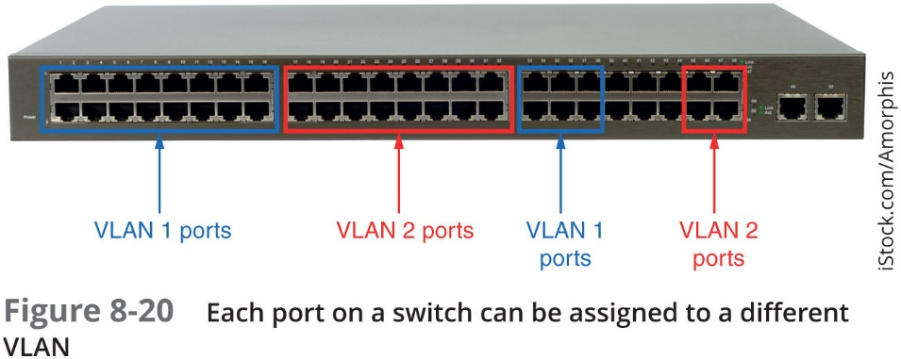
Managed Switches (5 of 8)
V LAN ports do not have to be next to each other
See Figure 8-20

Slide 34
Managed Switches (6 of 8)
802.1 Q
The I E E E standard that specifies how V LAN information appears in frames and how switches interpret that information
To identify the transmissions that belong to each V LAN
The switch adds a tag to Ethernet frames that identifies the port through which they arrive at the switch
Tag travels with transmission until it reaches a router or the switch port connected to the destination device (whichever comes first)
If frame is being routed to a new V LAN:
Router adds a new tag
Tag is removed once frame reaches its final switch port

Slide 35
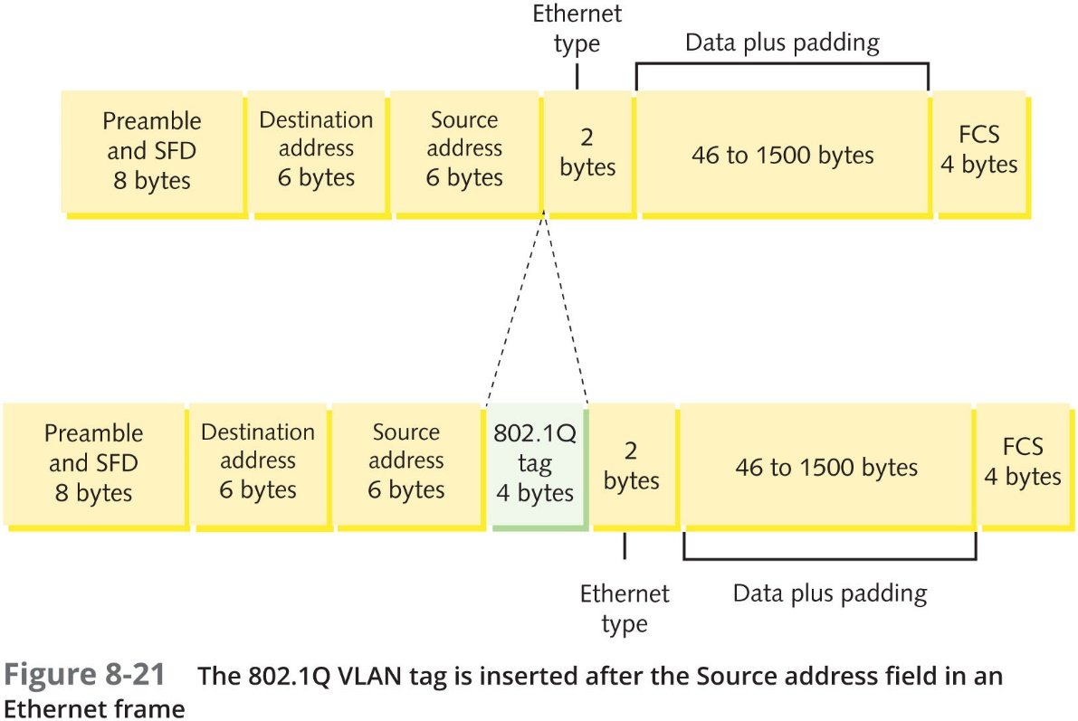
Managed Switches (7 of 8)

Slide 36
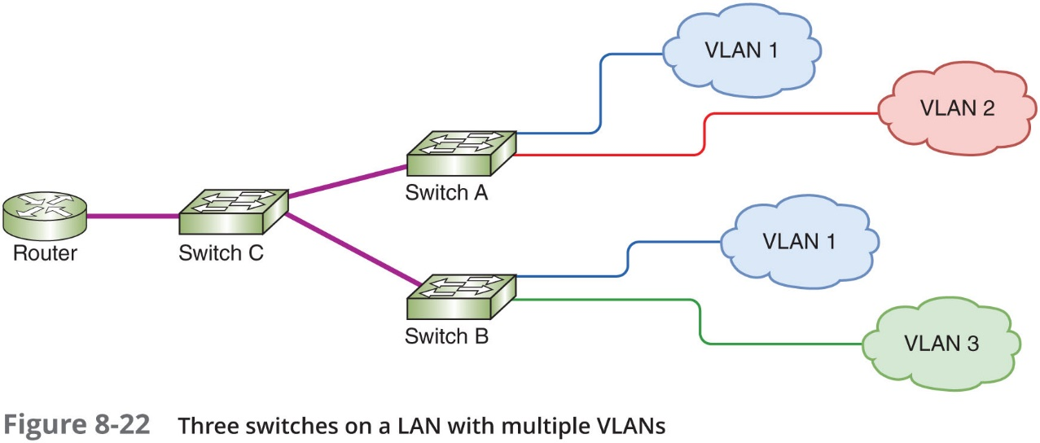
Managed Switches (8 of 8)

Slide 37
Switch Ports and Trunks (1 of 3)
A port on a switch is configured as either an access port or a trunk port:
Access port—Used for connecting a single node
Trunk port—Capable of managing traffic among multiple V LANs
Trunk
A single physical connection between switches through which many logical V LANs can transmit and receive data
Trunking protocols assign and interpret V LAN tags in Ethernet frames
Cisco’s V T P (V LAN trunking protocol):
The most popular protocol for exchanging V LAN information over trunks
V T P allows changes to V LAN database on one switch, called the stack master, to be communicated to all other switches in the network

Slide 38
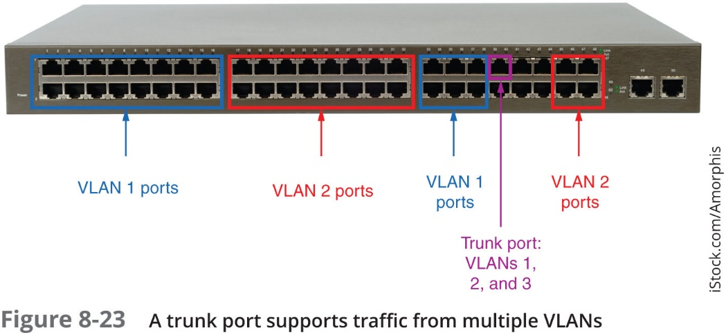
Switch Ports and Trunks (2 of 3)

Slide 39
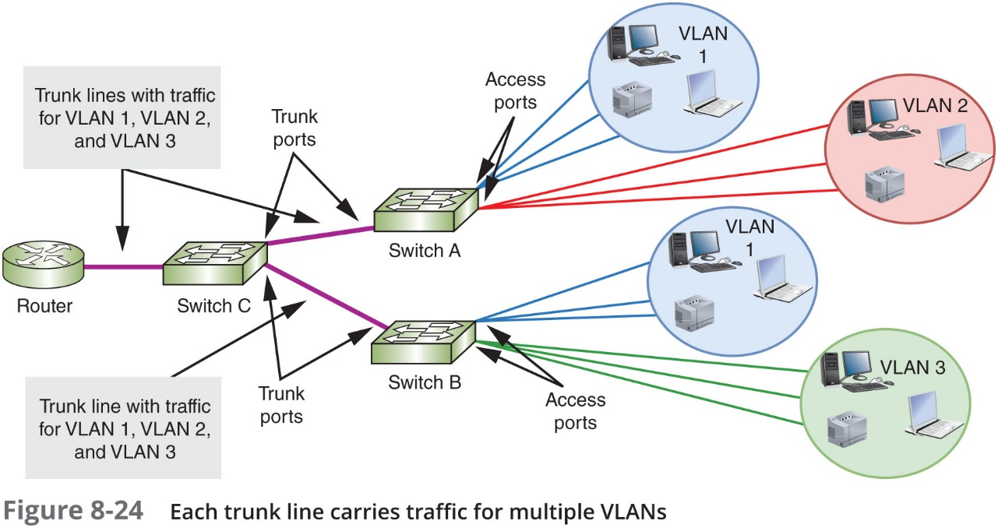
Switch Ports and Trunks (3 of 3)

Slide 40
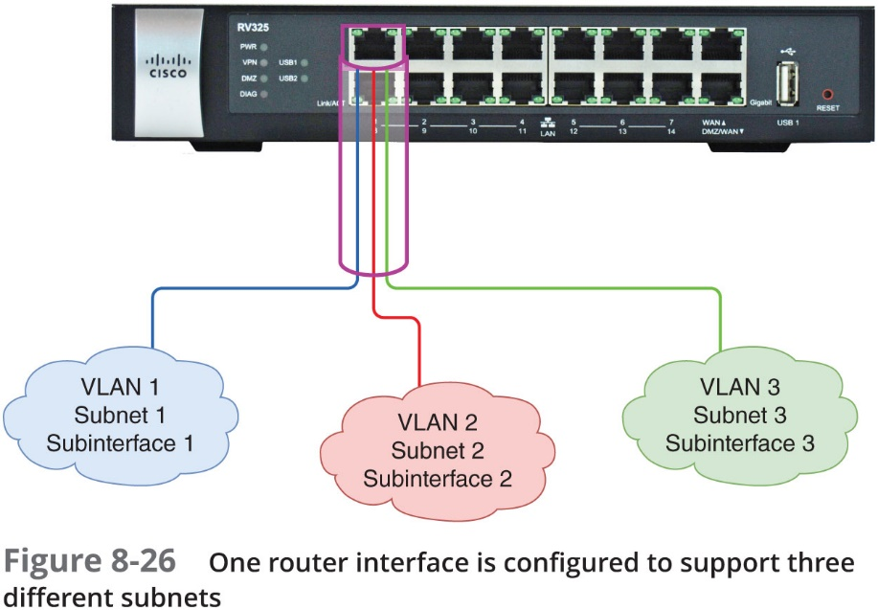
V LANs and Subnets
Each V LAN is assigned its own subnet of I P addresses
Sample network in Figure 8-22 (See on slide 36) is divided into three subnets
Router sees three logical, virtual LANs connected to a single router port

Slide 41
Types of V LANs
V LAN types:
Default V LAN—Typically preconfigured on a switch and initially includes all switch ports
Native V LAN—Receives all untagged frames from untagged ports
Data V LAN—Carries user-generated traffic, such as email, web browsing, or database updates
Management V LAN—Can be used to provide administrative access to a switch
Voice V LAN—Supports V o I P traffic

Slide 42
View Configured V LANs (1 of 2)
Once created maintain V LANs via switch software
Figure 8-27 (See next slide) illustrates the result of a show vlan command on a Cisco switch
This command is used to list the current V LAN recognized by a switch

Slide 43
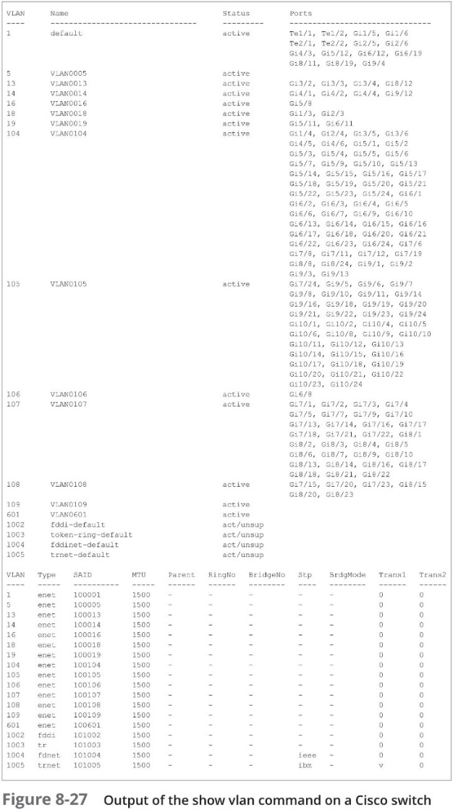
View Configured V LANs (2 of 2)

Slide 44
Troubleshoot and Secure V LANs (1 of 3)
Common configuration errors:
Incorrect port mode—Switch ports connected to endpoints should nearly always use access mode
Incorrect V LAN assignment—Can happen due to a variety of situations
V LAN isolation—You can potentially cut off an entire group from the rest of the network
V LAN hopping:
Occurs when an attacker generates transmissions that appear to belong to a protected V LAN
Crosses V LANs to access sensitive data or inject harmful software

Slide 45
Troubleshoot and Secure V LANs (2 of 3)
Two approaches to V LAN hopping:
Double tagging—Hacker stacks V LAN tags in Ethernet frames
First, legitimate tag is removed by switch
Second, illegitimate tag is revealed, tricking switch into forwarding transmission on to a restricted V LAN
Switch spoofing—Attacker connects to a switch and makes the connection look to the switch as if it’s a trunk line
Hacker can feed his own V LAN traffic into that port and access V LANs throughout the network

Slide 46
Troubleshoot and Secure V LANs (3 of 3)
Mitigation efforts to reduce the risk of V LAN hopping:
Don’t use the default V LAN
Change the native V LAN to an unused V LAN I D
Disable auto-trunking on switches that don’t need to support traffic from multiple V LANs
On switches that carry traffic from multiple V LANs, configure all ports as access ports unless they are used as trunk ports
Specify which V LANs are supported on each trunk instead of accepting a range of all V LANs
Use physical security methods such as door locks to restrict access to network equipment

Slide 47
Chapter Summary (1 of 3)
When a network is segmented into multiple smaller networks, traffic on one network is separated from another network’s traffic
Subnetting helps solve the fundamental problem with classful addressing
Computers compare the bits in their own network I D to the bits in the network I D of the destination host
C I D R notation takes the network I D or a host’s IP address and follows it with a forward slash (/) followed by the number of bits used for network I D
To create a subnet, borrow bits that would represent host information in classful addressing

Slide 48
Chapter Summary (2 of 3)
Class A, Class B, and Class C networks can all be subnetted
Two types of subnet calculation problems likely on Network+ exam: calculate possible subnets or calculate subnet information for a single IP address
In dynamic addressing, administrator programs each subnet’s D H C P server with the network I D, subnet mask, range of IP addresses, and default gateway
V L S M allows subnets to be further subdivided into smaller and smaller groupings until each subnet is about the same size as the I P address space that is needed
Subnetting in IPv6 is simpler than subnetting in I P v 4
A V LAN groups ports on a switch so that some of the local traffic is forced to go through a router creating a smaller broadcast domain

Slide 49
Chapter Summary (3 of 3)
Managed switches can be configured via a command-line interface or a web-based management G U I
A single switch can support traffic belonging to several V LANs across the network
In most situations, each V LAN is assigned its own subnet of IP addresses
Just as different types of I P addresses serve different purposes, so different types of V LANS
Once you create a V LAN, you also maintain it via the switch’s software
Hackers sometimes take advantage of the way V LANs are tagged to implement an attack called V LAN hopping

